Slide 1
Object Oriented Programming: Introduction

Slide 2
Topics to be covered
Introduction to OOP
Features
- Objects & Class
- Encapsulation & Abstraction
- Polymorphism
Advantages

Slide 3
Introduction
Most popular way of analysing, designing, and developing application systems, especially large ones
Real world problems can be decomposed into objects and object relationships
Define a software system as a collection of objects of various types that interact with each other through well-defined interfaces

Slide 4
Continue…
Object-oriented methodology provides with a step-by-step process for software design, a language to specify the output from each step of the process so that we can transition smoothly from one stage to the next, the ability to reuse earlier designs, standard solutions that adhere to well-reasoned design principles and, even the ability to incrementally fix a poor design without breaking the system.

Slide 5
Features
Objects
Class
Encapsulation
Abstraction
Inheritance
Polymorphism

Slide 6
Objects
Composite data types
Provides for the storage of multiple data values in a single unit
Each element is referred to as a property
Instances of a class
Created based on the rules set forth in the class definition
Bring together related data elements into a logical grouping
In an object, a data element is called a property, while the rules the object contains for processing those values are called methods

Slide 7
Continue…
have state and behaviour
Every object, at any given point of time would have to have a set of attributes defining its state
Every object based on its state and optionally
identity will have particular behaviour
E.g.,1. Dogs have state (name, colour, and breed, hungry) and behaviour (barking, fetching, wagging tail). 2. Bicycles also have state (current gear, current pedal cadence, and current speed) and behaviour (changing gear, changing pedal cadence, applying brakes).

Slide 8
Class
A definition, or description, of how the object is supposed to be created, what it contains, and how it work
Collection of similar objects
A template where certain basic characteristics of a set of objects are defined
Defines the basic attributes and the operations of the objects of that type
Blueprint of an object

Slide 9
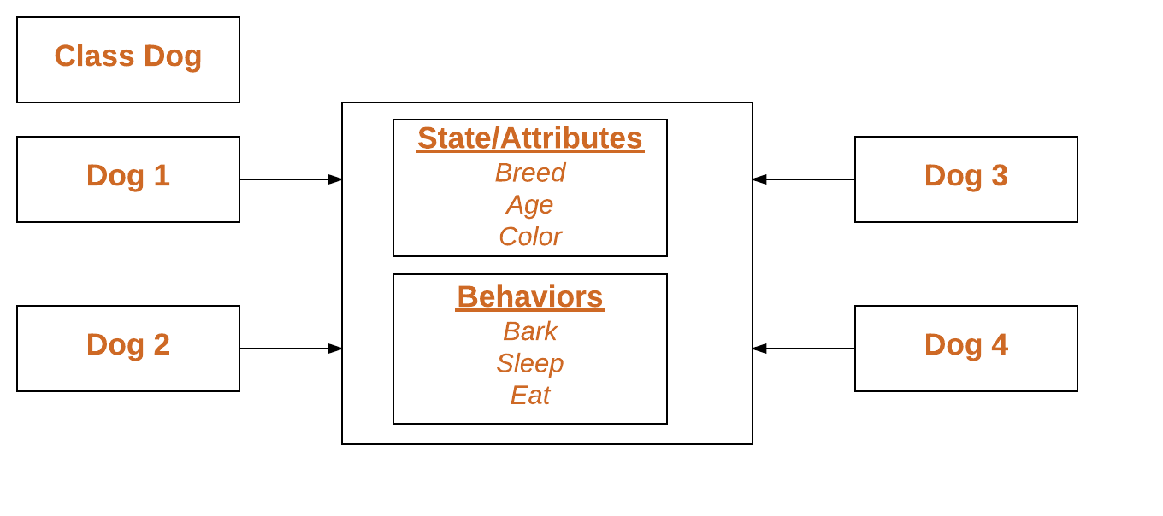
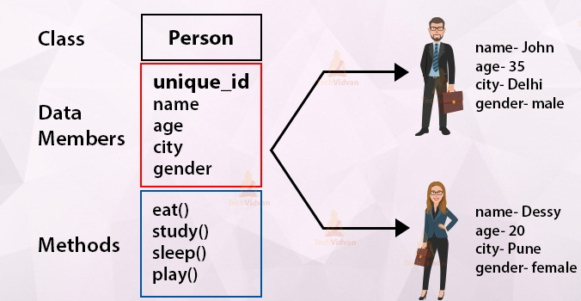
Continue…

Slide 10
Encapsulation
Separates the external aspects of an object from the internal implementation details
Prevents portions of a program from becoming so interdependent that a small change has massive ripple effects

Slide 11
Abstraction
The characteristics of concern to the system under observation are picked up and the class definition is made
The attributes of no concern to the system are left out
Only providing the essential features and hiding the details of implementation
The abstraction of an object varies according to its application
E.g., while defining a pen class for a stationery shop, the attributes of concern might be the pen colour, ink colour, pen type etc., whereas a pen class for a manufacturing firm would be containing the other dimensions of the pen like its diameter, its shape and size etc.

Slide 12
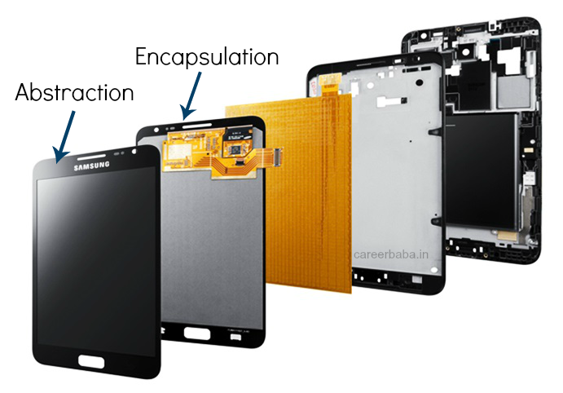
Continue…

Slide 13
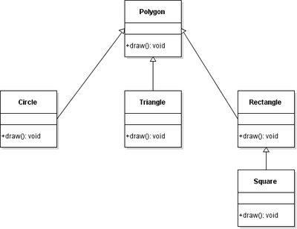
Inheritance
Idea of reusability of the objects
A new type of class can be defined using a similar existing class with a few new features

Slide 14
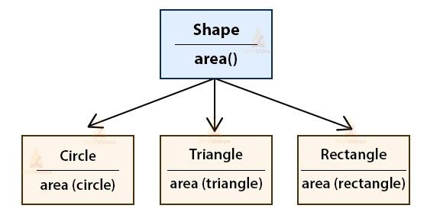
Polymorphism
Ability of an object to take on many forms
Ability of a message to be displayed in more than one form
E.g., a person at the same time can have different characteristics. Like a man at the same time is a father, a husband, an employee

Slide 15
Advantages
Object Oriented Methodology closely represents the problem domain. Because of this, it is easier to produce and understand designs.
The objects in the system are immune to requirement changes. Therefore, allows changes more easily
Object Oriented Methodology designs encourage more re-use. New applications can use the existing modules, thereby reduces the development cost and cycle time
Object Oriented Methodology approach is more natural. It provides nice structures for thinking and abstracting and leads to modular design

